Slide 1
lnitial Concepts

Slide 2
Contents
What is front-end development?
Who is front-end developer?
Front-end development explained?
Fundamentals of front-end development?
What is back-end development?
Who is back-end developer?
Basics of back-end development?
Back-end development technologies?
What is API?
What is database & how it works?
What is SQL?
What is SEO in web development?

Slide 3
01
Front-end
What is front-end development?
Who is front-end developer?
Front-end development explained?
Fundamentals of front-end development?

Slide 4
Front-End
What is front-end development?
It is a process that covers all visual, audio part of website creation and content. When you visit websites, the colorful themes, backgrounds, fonts, design images, and layout you use to make them stand out from the crowd is called the front-end.

Slide 5
Front-End
Who is front-end developer?
A front-end developer is a programmer who focuses on developing the elements of a website that users experience. They focus on visible website features like navigation bars, buttons, images, articles and widgets. They can also add visual elements to websites to make them aesthetically appealing.

Slide 6
Front-End
Front-end development explained?
Fundamentals of front-end development?
The three main languages you need to know well are HTML, CSS, and JavaScript. From there you can focus on frameworks, libraries, and other useful tools.
HTML
CSS
01
02
Mercury is the closest planet to the sun
Venus is the second planet from the sun
JavaScript
03
Jupiter is the biggest planet of them all

Slide 7
02
SEO
What is SEO in web development?

Slide 8
SEO
What is SEO in web development?
SEO stands for “search engine optimization.” The better visibility your pages have in search results, the more likely you are to be found and clicked on.

Slide 9
03
Back-end
What is back-end development?
Who is back-end developer?
Basics of back-end development?
Back-end development technologies?

Slide 10

Back-end
What is back-end development?
Who is back-end developer?
Back-end development means working on server-side software, which focuses on everything you can’t see on a website. Back-end developers ensure the website performs correctly, focusing on databases, back-end logic, application programming interface (APIs), architecture, and servers.

Slide 11
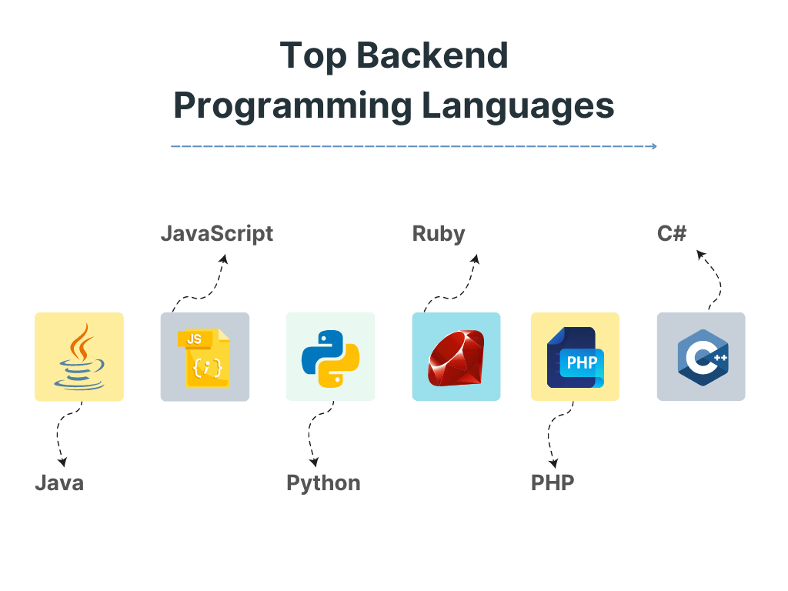
Back-end
Basics of back-end development?
Back-end development technologies?

Slide 12
04
API
What is API?

Slide 13

API-(Application Programming Interface)
What is API?
APIs are mechanisms that enable two software components to communicate with each other using a set of definitions and protocols. For example, the weather bureau’s software system contains daily weather data. The weather app on your phone “talks” to this system via APIs and shows you daily weather updates on your phone.

Slide 14
05
Database
What is database & how it works?
What is SQL?

Slide 15
Database
What is database & how it works?
Databases are used to store and manipulate data.Usually stored electronically on a computer, it allows for easy access, management, manipulation, and updating of data. Databases simplify data management. In other words, a database is a place where data is stored. It can be compared to a library, where the data would act as books.
A database is usually controlled by a database management system (DBMS). Most databases use structured query language (SQL) for writing and querying data.

Slide 16
Database
What is SQL?
SQL is a standard language for accessing and manipulating databases. SQL stands for Structured Query Language
SQL lets you access and manipulate databases
SQL became a standard of the American National Standards Institute (ANSI) in 1986, and of the International Organization for Standardization (ISO) in 1987
What Can SQL do?
SQL can execute queries against a database
SQL can insert records in a database
SQL can update records in a database
SQL can delete records from a database
SQL can create new databases
SQL can create new tables in a database
SQL can set permissions on tables, procedures, and views

Slide 17
Thanks!

